Slide 1
GIT Pharmacology
Omari B.G.
MbChb,Mmed.

Slide 2
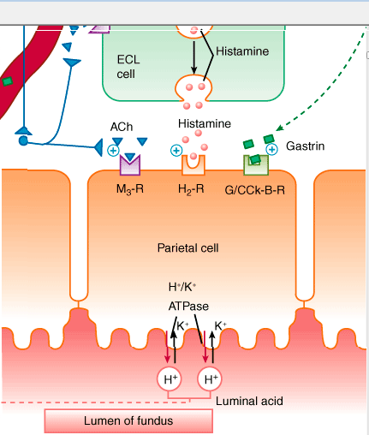
HCL secretion

Slide 3
Drugs used in acid peptic diseases
Acid-peptic diseases include ;
gastroesophageal reflux,
peptic ulcer (gastric and duodenal), and
stress-related mucosal injury.
Drugs used in the treatment of acid-peptic disorders may be divided into two classes: agents that reduce intragastric acidity and agents that promote mucosal defense.

Slide 4
Mucosal erosions or ulceration arise when the caustic effects of aggressive factors (acid, pepsin, bile) overwhelm the defensive factors of the gastrointestinal mucosa (mucus and bicarbonate secretion, prostaglandins, blood flow, and the processes of restitution and regeneration after cellular injury).
Over 90% of peptic ulcers are caused by infection with the bacterium Helicobacter pylori or by use of nonsteroidal anti-inflammatory drugs (NSAIDs).

Slide 5
Peptic Ulcer (PU)
Peptic ulcer – any ulcer in which the mucosa is bathed in HCl and gastric juice (i.e., stomach and upper duodenum).
Drugs treating these ulcers either decr gastic acid secretion or incr mucosal resistance.
Parietal cells’ secretion of HCl is decr by H₂-histamine antagonists or by H⁺ pump inhibitors (inhibit the pump that transports H⁺ ions out of the parietal cell).

Slide 6
Protective Factors
Mucus Layer
Physical Barrier ~ 0.5 mm thick on the surface of the stomach and proximal duodenum.
Consists of a mucus gel into which HCO₃⁻ is secreted.
Here, HCO₃⁻ neutralizes the acid diffusing into the lumen → pH gradient, even when the stomach contents are at pH 2.
PGs E₂ and I₂ synthesized by the gastric mucosa → cytoprotective action by stimulating the secretion of mucus and HCO₃⁻ and by incr mucus blood flow.

Slide 7
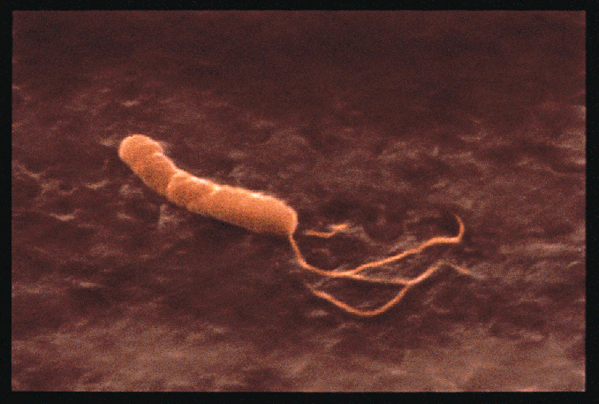

Slide 8
Ulcer healing drugs; H2 blockers
4 drugs are in clinical use;
cimetidine, ranitidine, famotidine, and nizatidine.
All four agents are rapidly absorbed from the intestine.
Cimetidine, ranitidine, and famotidine undergo first-pass hepatic metabolism resulting in a bioavailability of approximately 50%.
Nizatidine has little first-pass metabolism. The serum half-lives of the four agents range from 1.1 to 4 hours; however, duration of action depends on the dose given .

Slide 9
The H₂ antagonists exhibit competitive inhibition at the parietal cell H₂ receptor and suppress basal and meal-stimulated acid secretion in a linear, dose-dependent manner. They are highly selective and do not affect H₁ or H₃ receptors .
H₂ antagonists reduce acid secretion stimulated by histamine as well as by gastrin and cholinomimetic agents.

Slide 10
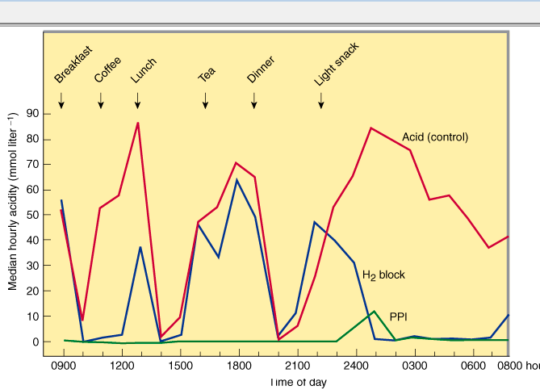
Acid suppression by H2 antagonists and PPIs

Slide 11
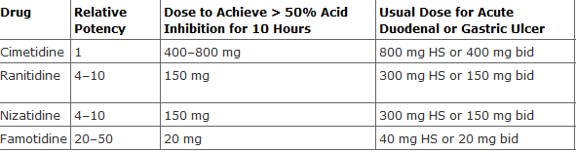

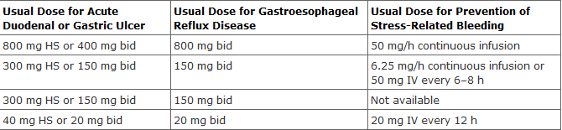
Clinical comparison of H2 blockers

Slide 12
Ulcer-Healing Drugs
Acid Secretion Reducers
H₂ antagonists are cleared by a combination of hepatic metabolism, glomerular filtration, and renal tubular secretion.
Dose reduction is required in patients with moderate to severe renal (and possibly severe hepatic) insufficiency.
In the elderly, there is a decline of up to 50% in drug clearance as well as a significant reduction in volume of distribution.
Cimetidine binds cyt P-450 and may decrease the hepatic metabolism of other drugs (e.g., warfarin, phenytoin, theophylline).

Slide 13
Adverse effects
Safe drugs Adverse effects occur in less than 3% of patients and include diarrhea, headache, fatigue, myalgias, and constipation.
Intravenous H₂ antagonists (or proton pump inhibitors) may increase the risk of nosocomial pneumonia in critically ill patients.
Cimetidine inhibits binding of dihydrotestosterone to androgen receptors, inhibits metabolism of estradiol, and increases serum prolactin levels.
When used long-term or in high doses, it may cause gynecomastia or impotence in men and galactorrhea in women.

Slide 14
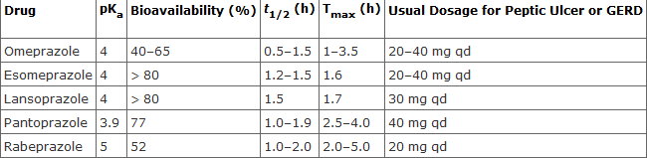
Proton pump inhibitors
Five proton pump inhibitors are available for clinical use: omeprazole, lansoprazole, rabeprazole, pantoprazole, and esomeprazole.

Slide 15
Proton pump inhibitors are administered as inactive prodrugs.
To protect the acid-labile prodrug from rapid destruction within the gastric lumen, oral products are formulated for delayed release as acid-resistant, enteric-coated capsules or tablets.
After passing through the stomach into the alkaline intestinal lumen, the enteric coatings dissolve and the prodrug is absorbed.

Slide 16
The bioavailability of all agents is decreased approximately 50% by food; hence, the drugs should be administered on an empty stomach.
Proton pump inhibitors should be administered approximately 1 hour before a meal (usually breakfast), so that the peak serum concentration coincides with the maximal activity of proton pump secretion.

Slide 17
The drugs have a short serum half-life of about 1.5 hours, but acid inhibition lasts up to 24 hours owing to the irreversible inactivation of the proton pump.
At least 18 hours are required for synthesis of new H⁺,K⁺ ATPase pump molecules
Since not all proton pumps are inactivated with the first dose of medication, up to 3–4 days of daily medication are required before the full acid-inhibiting potential is reached.
After stopping the drug, it takes 3–4 days for full acid secretion to return.

Slide 18
In contrast to H₂ antagonists, proton pump inhibitors inhibit both fasting and meal-stimulated secretion because they block the final common pathway of acid secretion, the proton pump.
In standard doses, proton pump inhibitors inhibit 90–98% of 24-hour acid secretion.

Slide 19
Clinical use
GERD; 70 -80 % effective. Once daily dosing but 15% may require twice daily dosing.
Non GI symptoms of GERD; may be treated up to 3 months.
PUD; All the pump inhibitors heal more than 90% of duodenal ulcers within 4 weeks and a similar percentage of gastric ulcers within 6–8 weeks.

Slide 20
H . Pylori associated ulcers.
NSAID induced ulcers
Stress related mucosal bleeding.
Gastrinomas and other hypersecretory conditions;

Slide 21
In patients with acute gastrointestinal bleeding due to peptic ulcers, the risk of rebleeding from ulcers that have a visible vessel or adherent clot is increased. Rebleeding of this subset of high-risk ulcers is reduced significantly with proton pump inhibitors administered for 3–5 days either as high-dose oral therapy (eg, omeprazole, 40 mg orally twice daily) or as a continuous intravenous infusion.
The optimal dose of intravenous proton pump inhibitor needed to achieve and maintain this level of near-complete acid inhibition is unknown; however, initial bolus administration (80 mg) followed by constant infusion (8 mg/h) is commonly recommended

Slide 22
Adverse effects.
Proton pump inhibitors are extremely safe. Diarrhea, headache, and abdominal pain are reported in 1–5% of patients.
Acid promotes absorption of food-bound minerals (iron, calcium, zinc); and vit B12. these can be affected by use of PPIs.
May be an increased risk of respiratory and enteric infections in patients.

Slide 23
Ulcer-Healing Drugs
Mucosal Strengtheners
Sucralfate polymerizes below pH 4 → a very sticky gel that adheres strongly to the base of ulcer craters.
Bismuth chelate (tripotassium dicitratobismuthate) acts similarly to sucralfate.
Strong affinity for mucosal glycoproteins, esp in the necrotic tissue of the ulcer craters, which become coated in a protective layer of polymer-glycoprotein complex.
Bismuth may blacken the teeth and stools.
Bismuth and sucralfate must be given on an empty stomach or they will complex with food proteins.

Slide 24
Dosage of sucralfate; 1g four times daily one hour before meals.
Reduces the incidence of clinically significant upper gastrointestinal bleeding in critically ill patients hospitalized in the intensive care unit, although it is slightly less effective than intravenous H₂ antagonists

Slide 25
Prostaglandin analogs
Misoprostol, analog of PGE1 , has been approved for gastrointestinal conditions.
After oral administration, it is rapidly absorbed and metabolized to a metabolically active free acid.
The serum half-life is less than 30 minutes; it must be administered 3–4 times daily.

Slide 26
Misoprostol has both acid inhibitory and mucosal protective properties. It is believed to stimulate mucus and bicarbonate secretion and enhance mucosal blood flow.
In addition, it binds to a prostaglandin receptor on parietal cells, reducing histamine-stimulated cAMP production and causing modest acid inhibition

Slide 27
Clinical uses
Peptic ulcers develop in approximately 10–20% of patients who receive long-term NSAID therapy.
Misoprostol reduces the incidence of NSAID-induced ulcers to less than 3% and the incidence of ulcer complications by 50%.
It is approved for prevention of NSAID-induced ulcers in high-risk patients.

Slide 28
Adverse effects
Diarrhea and cramping abdominal pain occur in 10–20% of patients.
Because misoprostol stimulates uterine contractions, it should not be used during pregnancy or in women of childbearing potential.

Slide 29
Antacids
Antacids are weak bases that react with gastric hydrochloric acid to form a salt and water.
Their principal mechanism of action is reduction of intragastric acidity.
After a meal, approximately 45 mEq/h of hydrochloric acid is secreted. A single dose of 156 mEq of antacid given 1 hour after a meal effectively neutralizes gastric acid for up to 2 hours.

Slide 30
Antacids (cont’d)
NaHCO₃⁻: the only useful H₂O-soluble antacid. Acts rapidly, but has a transient action. High doses may → systemic alkalosis.
Mg(OH)₂ and Mg trisilicate are H₂O-insoluble and have a fairly rapid action. Mg has a laxative effect and may → diarrhea.
Al(OH)₃: relatively slower action. Al³⁺ ions form complexes with certain drugs (e.g., tetracyclines) and tend to cause constipation.
Mixtures of Mg and Al may be used to minimize the effects on motility.

Slide 31
All antacids may affect the absorption of other medications by binding the drug (reducing its absorption) or by increasing intragastric pH so that the drug's dissolution or solubility (especially weakly basic or acidic drugs) is altered.
Antacids should not be given within 2 hours of doses of tetracyclines, fluoroquinolones, itraconazole, and iron.

Slide 32
GI Motility Stimulants
High concentrations of muscarinic M₁, histamine H₁, neurokinin 1 (NK₁), and serotonin5-HT₃ receptors have been identified in the vomiting center .
Important sources of input to vomiting center;
The chemoreceptor trigger zone is rich in dopamine D₂ receptors and opioid receptors, and possibly serotonin5-HT₃ receptors and NK₁ receptors.
vestibular system is important in motion sickness via cranial nerve VIII. It is rich in muscarinic M₁ and histamine H₁ receptors.
Vagal and spinal afferent nerves from the gastrointestinal tract are rich in 5-HT₃ receptors.

Slide 33
Motility and Secretions: Motility Stimulants
Metoclopramide and domperidone: Dopamine 2 receptor antagonists → blockade of central DA receptors in the chemoreceptor trigger zone → antinausea/antiemetic action.
Enhance contractions in stomach.
Enhance tone of lower esophageal sphincter.
Both actions → speed the transit of contents from the stomach

Slide 34
Clinical uses
Gastroesophageal Reflux Disease
These agents are sometimes used in the treatment of symptomatic GERD, prokinetic agents are used mainly in combination with antisecretory agents in patients with regurgitation or refractory heartburn.
Impaired Gastric Emptying
These agents are widely used in the treatment of patients with delayed gastric emptying due to postsurgical disorders (vagotomy, antrectomy) and diabetic gastroparesis. Metoclopramide is sometimes administered in hospitalized patients to promote advancement of nasoenteric feeding tubes from the stomach into the duodenum.

Slide 35
Nonulcer Dyspepsia
These agents lead to symptomatic improvement in a small number of patients with chronic dyspepsia.
Prevention of Vomiting
Because of their potent antiemetic action, metoclopramide and domperidone are used for the prevention and treatment of emesis.
Postpartum Lactation Stimulation
Domperidone is sometimes recommended to promote postpartum lactation

Slide 36
Adverse effects; metoclopramide
Central nervous system;Restlessness, drowsiness, insomnia, anxiety, and agitation occur in 10–20% of patients, especially the elderly.
Extrapyramidal effects (dystonias, akathisia, parkinsonian features) due to central dopamine receptor blockade occur acutely in 25% of patients given high doses and in 5% of patients receiving long-term therapy.
Tardive dyskinesia, sometimes irreversible, has developed in patients treated for a prolonged period with metoclopramide.

Slide 37
Domperidone is extremely well tolerated. Because it does not cross the blood-brain barrier to a significant degree, neuropsychiatric and extrapyramidal effects are rare.

Slide 38
Macrolide antibiotics
erythromycin directly stimulate motilin receptors on gastrointestinal smooth muscle and promote the onset of a migrating motor complex. Intravenous erythromycin (3 mg/kg) is beneficial in some patients with gastroparesis; however, tolerance rapidly develops.
It may be used in patients with acute upper gastrointestinal hemorrhage to promote gastric emptying of blood before endoscopy.

Slide 39
Selective 5HT3 antagonists
Selective 5-HT₃-receptor antagonists have potent antiemetic properties that are mediated in part through central 5-HT₃-receptor blockade in the vomiting center and chemoreceptor trigger zone but mainly through blockade of peripheral 5-HT₃ receptors on extrinsic intestinal vagal and spinal afferent nerves.
The antiemetic action of these agents is restricted to emesis attributable to vagal stimulation (eg, postoperative) and chemotherapy; other emetic stimuli such as motion sickness are poorly controlled.

Slide 40
5HT3 antagonists
Agents available
ondansetron,
granisetron,
dolasetron,
palonosetron,
tropisentron.

Slide 41
The first three agents (ondansetron, granisetron, and dolasetron, have a serum half-life of 4–9 hours and may be administered once daily by oral or intravenous routes.
All three drugs have comparable efficacy and tolerability when administered at equipotent doses.
Palonosetron is a newer intravenous agent that has greater affinity for the 5-HT₃ receptor and a long serum half-life of 40 hours.
All four drugs undergo extensive hepatic metabolism and are eliminated by renal and hepatic excretion. However, dose reduction is not required in geriatric patients or patients with renal insufficiency.
For patients with hepatic insufficiency, dose reduction may be required with ondansetron.

Slide 42
Clinical uses
Chemotherapy induced nausea and vomiting.
single dose by intravenous injection 30 minutes prior to administration of chemotherapy in the following doses: ondansetron, 8 mg or 0.15 mg/kg; granisetron, 1 mg; dolasetron, 100 mg; or palonosetron, 0.25 mg.
A single oral dose given 1 hour before chemotherapy may be equally effective in the following regimens: ondansetron 8 mg twice daily or 24 mg once; granisetron, 2 mg; dolasetron, 100 mg.
Although 5-HT₃-receptor antagonists are effective as single agents for the prevention of chemotherapy-induced nausea and vomiting, their efficacy is enhanced by combination therapy with a corticosteroid (dexamethasone) and NK₁-receptor antagonists.

Slide 43
well-tolerated agents with excellent safety profiles.
The most commonly reported adverse effects are headache, dizziness, and constipation.
All four agents cause a small but statistically significant prolongation of the QT interval, but this is most pronounced with dolasetron.
Although cardiac arrhythmias have not been linked to dolasetron, it should not be administered to patients with prolonged QT or in conjunction with other medications that may prolong the QT interval

Slide 44
Corticosteroids
Corticosteroids (dexamethasone, methylprednisolone) have antiemetic properties, but the basis for these effects is unknown.
These agents appear to enhance the efficacy of 5-HT₃-receptor antagonists for prevention of acute and delayed nausea and vomiting in patients receiving moderately to highly emetogenic chemotherapy regimens. Although a number of corticosteroids have been used, dexamethasone, 8–20 mg intravenously before chemotherapy, followed by 8 mg/d orally for 2–4 days, is commonly administered.

Slide 45
Neurokinin receptor antagonists
Neurokinin 1 (NK₁)-receptor antagonists have antiemetic properties that are mediated through central blockade in the area postrema. Aprepitant (an oral formulation) is a highly selective NK₁-receptor antagonist that crosses the blood-brain barrier and occupies brain NK₁ receptors. It has no affinity for serotonin, dopamine, or corticosteroid receptors. Fosaprepitant is an intravenous formulation that is converted within 30 minutes after infusion to aprepitant.

Slide 46
The oral bioavailability of aprepitant is 65%, and the serum half-life is 12 hours. Aprepitant is metabolized by the liver, primarily by the CYP3A4 pathway.
Clinical Uses
Aprepitant is used in combination with 5-HT₃-receptor antagonists and corticosteroids for the prevention of acute and delayed nausea and vomiting from highly emetogenic chemotherapeutic regimens.
NK₁-receptor antagonists may be administered for 3 days as follows: oral aprepitant 125 mg or intravenous fosaprepitant 115 mg given 1 hour before chemotherapy, followed by oral aprepitant 80 mg/d for 2 days after chemotherapy

Slide 47
Aprepitant may be associated with fatigue, dizziness, and diarrhea.
The drug is metabolized by CYP3A4 and may inhibit the metabolism of other drugs metabolized by the CYP3A4 pathway.
Drugs that inhibit CYP3A4 metabolism may significantly increase aprepitant plasma levels.
Aprepitant decreases the international normalized ratio (INR) in patients taking warfarin.

Slide 48
Phenothiazines and butyrophenones
The antiemetic properties of phenothiazines are mediated through inhibition of dopamine and muscarinic receptors.
Sedative properties are due to their antihistamine activity.
The agents most commonly used as antiemetics are prochlorperazine, promethazine, and thiethylperazine.

Slide 49
Antipsychotic butyrophenones also possess antiemetic properties due to their central dopaminergic blockade .
Droperidol can be given by intramuscular or intravenous injection. In antiemetic doses, droperidol is extremely sedating. Until recently, it was used extensively for postoperative nausea and vomiting.
Extrapyramidal effects and hypotension may occur. Droperidol may prolong the QT interval, rarely resulting in fatal episodes of ventricular tachycardia including torsade de pointes.
Therefore, droperidol should not be used in patients with QT prolongation and should be used only in patients who have not responded adequately to alternative agents

Slide 50
Substituted benzamides include metoclopramide and trimethobenzamide. Their primary mechanism of antiemetic action is believed to be dopamine-receptor blockade. Trimethobenzamide also has weak antihistaminic activity.
For prevention and treatment of nausea and vomiting, metoclopramide may be given in the relatively high dosage of 10–20 mg orally or intravenously every 6 hours.
The usual dose of trimethobenzamide is 250 mg orally, 200 mg rectally, or 200 mg by intramuscular injection.
The principal adverse effects of these central dopamine antagonists are extrapyramidal: restlessness, dystonias, and parkinsonian symptoms.

Slide 51
H1 antihistamines
As single agents, these drugs have weak antiemetic activity, although they are particularly useful for the prevention or treatment of motion sickness.
Their use may be limited by dizziness, sedation, confusion, dry mouth, cycloplegia, and urinary retention.
Diphenhydramine and one of its salts, dimenhydrinate, are first-generation histamine H₁ antagonists that also have significant anticholinergic properties.
Because of its sedating properties, diphenhydramine is commonly used in conjunction with other antiemetics for treatment of emesis due to chemotherapy.
Meclizine is an H₁ antihistaminic agent with minimal anticholinergic properties that also causes less sedation. It is used for the prevention of motion sickness and the treatment of vertigo due to labyrinth dysfunction.

Slide 52
Benzodiazepines such as lorazepam or diazepam are used before the initiation of chemotherapy to reduce anticipatory vomiting or vomiting caused by anxiety.
Dronabinol and nabilone are cannabinoids also used for prevention of chemotherapy induced nausea and vomiting.

Slide 53
Role of Laxatives
Constipation: abdominal discomfort, loss of appetite, and malaise from insufficient bowel movements.
Freq and vol of defecation best regulated by diet, but drugs may be needed for specific purposes (e.g., before surgery, colonoscopy).

Slide 54
Bulk laxatives
Bulk-forming laxatives are indigestible, hydrophilic colloids that absorb water, forming a bulky, emollient gel that distends the colon and promotes peristalsis.
Common preparations include natural plant products (psyllium, methylcellulose) and synthetic fibers (polycarbophil).
Bacterial digestion of plant fibers within the colon may lead to increased bloating and flatus.

Slide 55
Osmotic laxatives
The colon can neither concentrate nor dilute fecal fluid: fecal water is isotonic throughout the colon.
Osmotic laxatives are soluble but nonabsorbable compounds that result in increased stool liquidity due to an obligate increase in fecal fluid
Increase bulk in the bowel by retaining H₂O by an osmotic effect.
Include salts containing poorly absorbed ions (e.g., MgSO₄, Epsom salts) and lactulose (takes 48 hr to act and must be given regularly).

Slide 56
Patients should maintain oral hydration.
Sodium phosphate preparations should not be used in patients who are frail or elderly, have renal insufficiency, have significant cardiac disease, or are unable to maintain adequate hydration during bowel preparation.

Slide 57
Adverse effects
Sodium phosphate frequently causes hyperphosphatemia, hypocalcemia, hypernatremia, and hypokalemia.
Although these electrolyte abnormalities are clinically insignificant in most patients, they may lead to cardiac arrhythmias or acute renal failure due to tubular deposition of calcium phosphate (nephrocalcinosis)

Slide 58
Poly ethylene glycol
Lavage solutions containing polyethylene glycol (PEG) are used for complete colonic cleansing before gastrointestinal endoscopic procedures. These balanced, isotonic solutions contain an inert, nonabsorbable, osmotically active sugar (PEG) with sodium sulfate, sodium chloride, sodium bicarbonate, and potassium chloride.
The solution is designed so that no significant intravascular fluid or electrolyte shifts occur. Therefore, they are safe for all patients.
The solution should be ingested rapidly (2–4 L over 2–4 hours) to promote bowel cleansing. For treatment or prevention of chronic constipation, smaller doses of PEG powder may be mixed with water or juices (17 g/8 oz) and ingested daily.
In contrast to sorbitol or lactulose, PEG does not produce significant cramps or flatus.

Slide 59
Stool softeners
These agents soften stool material, permitting water and lipids to penetrate. They may be administered orally or rectally.
Common agents include docusate (oral or enema) and glycerin suppository. In hospitalized patients, docusate is commonly prescribed to prevent constipation and minimize straining.
Mineral oil is a clear, viscous oil that lubricates fecal material, retarding water absorption from the stool. It is used to prevent and treat fecal impaction in young children and debilitated adults.
Long-term use can impair absorption of fat-soluble vitamins (A, D, E, K).

Slide 60
Stimulant laxatives
Stimulant laxatives (cathartics) induce bowel movements through a number of poorly understood mechanisms. These include direct stimulation of the enteric nervous system and colonic electrolyte and fluid secretion.

Slide 61
Stimulant laxatives;anthraquinone derivatives
Aloe, senna, and cascara occur naturally in plants. These laxatives are poorly absorbed and after hydrolysis in the colon, produce a bowel movement in 6–12 hours when given orally and within 2 hours when given rectally. Chronic use leads to a characteristic brown pigmentation of the colon known as "melanosis coli."

Slide 62
Diphenylmethane derivatives
Bisacodyl is available in tablet and suppository formulations for the treatment of acute and chronic constipation.
It also is used in conjunction with PEG solutions for colonic cleansing prior to colonoscopy. It induces a bowel movement within 6–10 hours when given orally and 30–60 minutes when taken rectally. It has minimal systemic absorption and appears to be safe for acute and long-term use.
Phenolphthalein, another agent in this class, was removed from the market owing to concerns about possible cardiac toxicity

Slide 63
There has been concern that long-term use of cathartics could lead to dependence and destruction of the myenteric plexus, resulting in colonic atony and dilation. More recent research suggests that long-term use of these agents probably is safe in most patients. Cathartics may be required on a long-term basis, especially in patients who are neurologically impaired and in bed-bound patients in long-term care facilities.

Slide 64
Chloride channel activator
Lubiprostone is a prostanoic acid derivative labeled for use in chronic constipation and irritable bowel syndrome (IBS) with predominant constipation.
It acts by stimulating the type 2 chloride channel (ClC-2) in the small intestine. This increases chloride-rich fluid secretion into the intestine, which stimulates intestinal motility and shortens intestinal transit time.
Over 50% of patients experience a bowel movement within 24 hours of taking one dose.
Lubiprostone has minimal systemic absorption but is designated category C for pregnancy.

Slide 65
Opioid receptor antagonists
Use of opioids after surgery for treatment of pain as well as endogenous opioids also may prolong the duration of postoperative ileus. These effects are mainly mediated through intestinal mu ()-opioid receptors.
Two selective antagonists of the -opioid receptor are commercially available: methylnaltrexone bromide and alvimopan. Because these agents do not readily cross the blood-brain barrier, they inhibit peripheral -opioid receptors without impacting analgesic effects within the central nervous system.

Slide 66
Methylnaltrexone is approved for the treatment of opioid-induced constipation in patients receiving palliative care for advanced illness who have had inadequate response to other agents.
It is administered as a subcutaneous injection (0.15 mg/kg) every 2 days.
Alvimopan is approved for short-term use to shorten the period of postoperative ileus in hospitalized patients who have undergone small or large bowel resection. Alvimopan (12 mg capsule) is administered orally within 5 hours before surgery and twice daily after surgery until bowel function has recovered, but for no more than 7 days.
possible cardiovascular toxicity, alvimopan currently is restricted to short-term use in hospitalized patients only.

Slide 67
Serotonin 5HT4 receptor agonists
stimulate proximal bowel contraction (via acetylcholine and substance P) and distal bowel relaxation (via nitric oxide and vasoactive intestinal peptide).
Tegaserod; a 5-HT₄ partial agonist, → modest improvement in some patients with IBS-with-predominant constipation.
Withdrawn from market due to increased cardiovascular events due to inhibition of 5HT1b receptor.
Cisapride; partial 5 HT 4 receptor agonist.
Prucalopride; high affinity 5HT 4receptor agonist.

Slide 68
Anti diarrheal agents
Antidiarrheal agents may be used safely in patients with mild to moderate acute diarrhea.
control chronic diarrhea caused by such conditions as irritable bowel syndrome (IBS) or inflammatory bowel disease (IBD).

Slide 69
should not be used in patients with bloody diarrhea, high fever, or systemic toxicity because of the risk of worsening the underlying condition.
They should be discontinued in patients whose diarrhea is worsening despite therapy.

Slide 70
Opioid agonists
Loperamide is a nonprescription opioid agonist that does not cross the blood-brain barrier and has no analgesic properties or potential for addiction. Tolerance to long-term use has not been reported. It is typically administered in doses of 2 mg taken one to four times daily.
Diphenoxylate is a prescription opioid agonist that has no analgesic properties in standard doses; however, higher doses have central nervous system effects, and prolonged use can lead to opioid dependence. Commercial preparations commonly contain small amounts of atropine to discourage overdosage (2.5 mg diphenoxylate with 0.025 mg atropine). The anticholinergic properties of atropine may contribute to the antidiarrheal action.

Slide 71
Kaolin and pectin
Kaolin is a naturally occurring hydrated magnesium aluminum silicate (attapulgite), and pectin is an indigestible carbohydrate derived from apples. Both appear to act as absorbents of bacterial toxins and fluid, thereby decreasing stool liquidity and number. They may be useful in acute diarrhea but are seldom used on a chronic basis. A common nonprescription preparation is Kaopectate. The usual dosage is 1.2–1.5 g after each loose bowel movement (maximum: 9 g/d). Kaolin-pectin formulations are not absorbed and have no significant adverse effects except constipation. They should not be taken within 2 hours of other medications (which they may bind

Slide 72
Drugs used in treating irritable bowel syndrome

Slide 73
IBS is an idiopathic chronic, relapsing disorder characterized by abdominal discomfort (pain, bloating, distention, or cramps) in association with alterations in bowel habits (diarrhea, constipation, or both).
With episodes of abdominal pain or discomfort, patients note a change in the frequency or consistency of their bowel movements

Slide 74
Pharmacologic therapies for IBS are directed at relieving abdominal pain and discomfort and improving bowel function.
For patients with predominant diarrhea, antidiarrheal agents, especially loperamide, are helpful in reducing stool frequency and fecal urgency. For patients with predominant constipation, fiber supplements may lead to softening of stools and reduced straining; however, increased gas production may exacerbate bloating and abdominal discomfort.
Consequently, osmotic laxatives, especially milk of magnesia, are commonly used to soften stools and promote increased stool frequency.

Slide 75
For chronic abdominal pain, low doses of tricyclic antidepressants (eg, amitriptyline or desipramine, 10–50 mg/d) .
At these doses, these agents have no effect on mood but may alter central processing of visceral afferent information.
The anticholinergic properties of these agents also may have effects on gastrointestinal motility and secretion, reducing stool frequency and liquidity.
tricyclic antidepressants may alter receptors for enteric neurotransmitters such as serotonin, affecting visceral afferent sensation.

Slide 76
Anti spasmodics
Antispasmodics work primarily through anticholinergic activities.
Commonly used medications in this class include dicyclomine and hyoscyamine.
These drugs inhibit muscarinic cholinergic receptors in the enteric plexus and on smooth muscle
At high doses they exhibit significant additional anticholinergic effects, including dry mouth, visual disturbances, urinary retention, and constipation.

Slide 77
Serotonin 5HT 3 receptor antagonists
Alosetron is a 5-HT₃ antagonist that has been approved for the treatment of patients with severe IBS with diarrhea .
A highly potent and selective antagonist of the 5-HT₃ receptor.
It is rapidly absorbed from the gastrointestinal tract with a bioavailability of 50–60% and has a plasma half-life of 1.5 hours but a much longer duration of effect. It undergoes extensive hepatic cytochrome P450 metabolism with renal excretion of most metabolites.

Slide 78
Alosetron is a highly potent and selective antagonist of the 5-HT₃ receptor. It is rapidly absorbed from the gastrointestinal tract with a bioavailability of 50–60% and has a plasma half-life of 1.5 hours but a much longer duration of effect. It undergoes extensive hepatic cytochrome P450 metabolism with renal excretion of most metabolites. Alosetron binds with higher affinity and dissociates more slowly from 5-HT₃ receptors than other 5-HT₃ antagonists, which may account for its long duration of action.

Slide 79
In a dosage of 1 mg once or twice daily, it reduces IBS-related lower abdominal pain, cramps, urgency, and diarrhea.
Approximately 50–60% of patients report adequate relief of pain and discomfort with alosetron.
It also leads to a reduction in the mean number of bowel movements per day and improvement in stool consistency.

Slide 80
Constipation occurs in up to 30% of patients with diarrhea-predominant IBS, requiring discontinuation of the drug .
Episodes of ischemic colitis—some fatal—have been reported in up to 3 per 1000 patients. Alosetron is restricted to women with severe diarrhea-predominant IBS who have not responded to conventional therapies and who have been educated about the relative risks and benefits.

Slide 81
Other drugs used in irritable bowel syndrome;
Tegaserod; partial 5HT4 receptor agonist for predominant constipation.
chloride channel activator; lupiprostone; for predominant constipation. The approved dose for IBS is 8 mcg twice daily (compared with 24 mcg twice daily for chronic constipation). Lubiprostone is listed as category C for pregnancy.

Slide 82
Drugs used in management of inflammatory bowel disease

Slide 83
Inflammatory bowel disease (IBD) comprises two distinct disorders: ulcerative colitis and Crohn's disease.
pharmacologic treatment of inflammatory bowel disorders often involves drugs that belong to different therapeutic classes and have different but nonspecific mechanisms of anti-inflammatory action.
Drugs used in inflammatory bowel disease are chosen on the basis of disease severity, responsiveness, and drug toxicity.

Slide 84
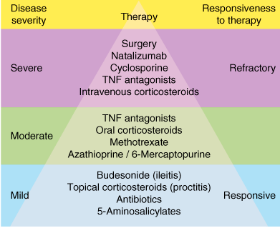

Slide 85
Drugs that contain 5-aminosalicylic acid (5-ASA are believed to work topically (not systemically) in areas of diseased gastrointestinal mucosa.
Up to 80% of unformulated, aqueous 5-ASA is absorbed from the small intestine and does not reach the distal small bowel or colon in appreciable quantities.
To overcome the rapid absorption of 5-ASA from the proximal small intestine, a number of formulations have been designed to deliver 5-ASA to various distal segments of the small bowel or the colon.
These include sulfasalazine, olsalazine, balsalazide, and various forms of mesalamine.

Slide 86
It is thought that 5-ASA modulates inflammatory mediators derived from both the cyclooxygenase and lipoxygenase pathways.
Other potential mechanisms of action of the 5-ASA drugs relate to their ability to interfere with the production of inflammatory cytokines. 5-ASA inhibits the activity of nuclear factor-B (NF-B), an important transcription factor for proinflammatory cytokines. 5-ASA may also inhibit cellular functions of natural killer cells, mucosal lymphocytes, and macrophages, and it may scavenge reactive oxygen metabolites

Slide 87
Clinical uses; 5 ASA
5-ASA drugs induce and maintain remission in ulcerative colitis and are considered to be the first-line agents for treatment of mild to moderate active ulcerative colitis.
Their efficacy in Crohn's disease is unproven, although many clinicians use 5-ASA agents as first-line therapy for mild to moderate disease involving the colon or distal ileum.

Slide 88
40% of patients cannot tolerate therapeutic doses of sulfasalazine. The most common problems are dose-related and include nausea, gastrointestinal upset, headaches, arthralgias, myalgias, bone marrow suppression, and malaise.
Hypersensitivity to sulfapyridine (or, rarely, 5-ASA) can result in fever, exfoliative dermatitis, pancreatitis, pneumonitis, hemolytic anemia, pericarditis, or hepatitis.
Sulfasalazine impairs folate absorption and processing; hence, dietary supplementation with 1 mg/d folic acid is recommended.
In contrast to sulfasalazine, other aminosalicylate formulations are well tolerated

Slide 89
Glucocorticoids
Mainly prednisone, prednisolone.
Others; budesonide, hydrocortisone enemas ,foam ,suppositories.
glucocorticoids inhibit production of inflammatory cytokines (TNF-, IL-1) and chemokines (IL-8); reduce expression of inflammatory cell adhesion molecules; and inhibit gene transcription of nitric oxide synthase, phospholipase A₂, cyclooxygenase-2, and NF-B.

Slide 90
Glucocorticoids are commonly used in the treatment of patients with moderate to severe active inflammatory bowel disease.
Active disease is commonly treated with an initial oral dosage of 40–60 mg/d of prednisone or prednisolone
Once a patient responds to initial therapy (usually within 1–2 weeks), the dosage is tapered to minimize development of adverse effects. In severely ill patients, the drugs are usually administered intravenously.
For the treatment of inflammatory bowel disease involving the rectum or sigmoid colon, rectally administered glucocorticoids are preferred because of their lower systemic absorption.

Slide 91
Oral controlled-release budesonide (9 mg/d) is commonly used in the treatment of mild to moderate Crohn's disease involving the ileum and proximal colon.
Corticosteroids are not useful for maintaining disease remission. Other medications such as aminosalicylates or immunosuppressive agents should be used for this purpose.

Slide 92
Purine analogs
Azathioprine and 6-mercaptopurine (6-MP) are purine antimetabolites that have immunosuppressive properties .
are important agents in the induction and maintenance of remission of ulcerative colitis and Crohn's disease.
1–1.5 mg/kg/d, or azathioprine, 2–2.5 mg/kg/d. After 3–6 months of treatment, 50–60% of patients with active disease achieve remission. These agents help maintain remission in up to 80% of patients. Among patients who depend on long-term glucocorticoid therapy to control active disease, purine analogs allow dose reduction or elimination of steroids in the majority.

Slide 93
Dose-related toxicities of azathioprine or 6-MP include nausea, vomiting, bone marrow depression (leading to leukopenia, macrocytosis, anemia, or thrombocytopenia), and hepatic toxicity.
Routine laboratory monitoring with complete blood count and liver function tests is required in all patients.

Slide 94
Methotrexate is used to induce and maintain remission in patients with Crohn's disease.
To induce remission, patients are treated with 15–25 mg of methotrexate once weekly by subcutaneous injection. If a satisfactory response is achieved within 8–12 weeks, the dose is reduced to 15 mg/wk.

Slide 95
At higher dosage, methotrexate may cause bone marrow depression, megaloblastic anemia, alopecia, and mucositis.
At the doses used in the treatment of inflammatory bowel disease, these events are uncommon but warrant dose reduction if they do occur.
Folate supplementation reduces the risk of these events without impairing the anti-inflammatory action.

Slide 96
Ant TNF Ab
Three monoclonal antibodies to human TNF are approved for the treatment of inflammatory bowel disease: infliximab, adalimumab, and certolizumab.

Slide 97
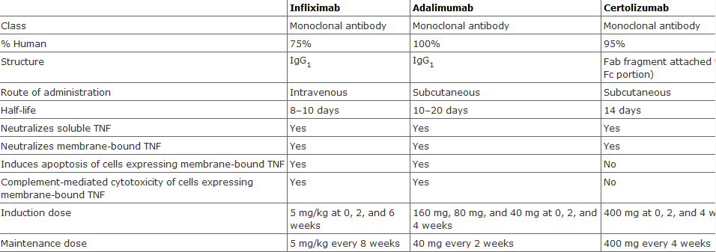

Slide 98
All three agents are approved for the acute and chronic treatment of patients with moderate to severe Crohn's disease who have had an inadequate response to conventional therapies.
Infliximab also is approved for the acute and chronic treatment of moderate to severe ulcerative colitis.
The median time to clinical response is 2 weeks. Induction therapy is generally given as follows: infliximab 5 mg/kg intravenous infusion at 0, 2, and 6 weeks; adalimumab 160 mg (in divided doses) initially and 80 mg subcutaneous injection at 2 weeks; and certolizumab 400 mg subcutaneous injection at 0, 2, and 4 weeks

Slide 99
Patients who respond may be treated with chronic maintenance therapy, as follows: infliximab 5 mg/kg intravenous infusion every 8 weeks; adalimumab 40 mg subcutaneous injection every 2 weeks; certolizumab 400 mg subcutaneous injection every 4 weeks.
However, one-third of patients eventually lose response despite higher doses or more frequent injections. Loss of response in many patients may be due to the development of antibodies to the TNF antibody or to other mechanisms.

Slide 100
Infliximab is approved for the treatment of patients with moderate to severe ulcerative colitis who have had inadequate response to mesalamine or corticosteroids.
induction therapy of 5–10 mg/wk at 0, 2, and 6 weeks.
With continued maintenance infusions every 8 weeks, approximately 50% of patients have continued clinical response.

Slide 101
Side effeccts; anti - TNF
The most important adverse effect of these drugs is infection due to suppression of the TH1 inflammatory response.
This may lead to serious infections such as bacterial sepsis, tuberculosis, invasive fungal organisms, reactivation of hepatitis B, listeriosis, and other opportunistic infections.
Reactivation of latent tuberculosis, with dissemination, has occurred.

Slide 102
Rare but serious adverse effects of all anti-TNF agents also include severe hepatic reactions leading to acute hepatic failure, demyelinating disorders, hematologic reactions, and new or worsened congestive heart failure in patients with underlying heart disease.

Slide 103
Anti intergrin therapy
Intergrins are adhesion molecules on the surface of leukocytes that may interact with another class of adhesion molecules on the surface of the vascular endothelium known as selectins, allowing circulating leukocytes to adhere to the vascular endothelium and subsequently move through the vessel wall into the tissue.
Natalizumab is a humanized IgG₄ monoclonal antibody targeted against the 4 subunit, which thereby blocks several integrins on circulating inflammatory cells.

Slide 104
Used for patients with moderate to severe Crohn's disease who have failed other therapies.
The approved dosage is 300 mg every 4 weeks by intravenous infusion, and patients should not be on other immune suppressant agents.

Slide 105
Pancreatic enzyme supplements
Exocrine pancreatic insufficiency is most commonly caused by cystic fibrosis, chronic pancreatitis, or pancreatic resection. When secretion of pancreatic enzymes falls below 10% of normal, fat and protein digestion is impaired and can lead to steatorrhea, azotorrhea, vitamin malabsorption, and weight loss.
Azatorrhea-excessive discharge of nitrogenous substances in feces or urine

Slide 106
Pancreatic enzyme supplements, which contain a mixture of amylase, lipase, and proteases, are the mainstay of treatment for pancreatic enzyme insufficiency. Two major types of preparations in use are pancreatin and pancrelipase.
Pancreatin is an alcohol-derived extract of hog pancreas with relatively low concentrations of lipase and proteolytic enzymes, whereas pancrelipase is an enriched preparation.
pancrelipase has approximately 12 times the lipolytic activity and more than 4 times the proteolytic activity of pancreatin.

Slide 107
Pancrelipase is available in both non–enteric-coated and enteric-coated preparations. Pancrelipase enzymes are rapidly and permanently inactivated by gastric acids.
Non–enteric-coated preparations should be given concomitantly with acid suppression therapy (proton pump inhibitor or H2 antagonist) to reduce acid-mediated destruction within the stomach. Encapsulated formulations contain acid-resistant microspheres or microtablets .
Enteric-coated formulations are more commonly used because they do not require concomitant acid suppression therapy.

Slide 108
Drugs Used to Dissolve Gallstones
The solubility of cholesterol in bile is determined by the relative proportions of bile acids, lecithin, and cholesterol.
Incr [cholesterol] or decr bile salts → cholesterol stones.
Small non-calcified stones may be dissolved by prolonged oral administration of the bile acid, urodeoxycholic acid, which decr the cholesterol content of bile by reducing hepatic cholesterol secretion.

Slide 109
Ursodiol is used for dissolution of small cholesterol gallstones in patients with symptomatic gallbladder disease who refuse cholecystectomy or who are poor surgical candidates.
At a dosage of 10 mg/kg/d for 12–24 months, dissolution occurs in up to 50% of patients with small (< 5–10 mm) noncalcified gallstones.
It is also effective for the prevention of gallstones in obese patients undergoing rapid weight loss therapy. Several trials demonstrate that ursodiol 13–15 mg/kg/d is helpful for patients with early-stage primary biliary cirrhosis, reducing liver function abnormalities and improving liver histology.

Slide 110
Drugs used for variceal hemorrhage

Slide 111
Somatostatins and octreotide
In patients with cirrhosis and portal hypertension, intravenous somatostatin (250 mcg/h) or octreotide (50 mcg/h) reduces portal blood flow and variceal pressures; however, the mechanism by which they do so is poorly understood.
Although data from clinical trials are conflicting, these agents are probably effective in promoting initial hemostasis from bleeding esophageal varices. They are generally administered for 3–5 days.

Slide 112
Vasopressin and terlipressin
Vasopressin (antidiuretic hormone);
its primary physiologic role is to maintain serum osmolality, it is also a potent arterial vasoconstrictor.
When administered intravenously by continuous infusion, vasopressin causes splanchnic arterial vasoconstriction that leads to reduced splanchnic perfusion and lowered portal venous pressures. Before the advent of octreotide, vasopressin was commonly used to treat acute variceal hemorrhage
In contrast, for patients with acute gastrointestinal bleeding from small bowel or large bowel vascular ectasias or diverticulosis, vasopressin may be infused—to promote vasospasm—into one of the branches of the superior or inferior mesenteric artery through an angiographically placed catheter.

Slide 113
Systemic and peripheral vasoconstriction can lead to hypertension, myocardial ischemia or infarction, or mesenteric infarction.
Other common adverse effects are nausea, abdominal cramps, and diarrhea (due to intestinal hyperactivity). Furthermore, the antidiuretic effects of vasopressin promote retention of free water, which can lead to hyponatremia, fluid retention, and pulmonary edema.
Terlipressin is a vasopressin analog that appears to have similar efficacy to vasopressin with fewer adverse effects.

Slide 114
Beta-receptor antagonists reduce portal venous pressures via a decrease in portal venous inflow. This decrease is due to a decrease in cardiac output (₁ blockade) and to splanchnic vasoconstriction (₂ blockade) caused by the unopposed effect of systemic catecholamines on receptors.
Thus, nonselective blockers such as propranolol and nadolol are more effective than selective b blockers. They significantly reduce the rate of recurrent bleeding, although a reduction in mortality is unproved.

Slide 115
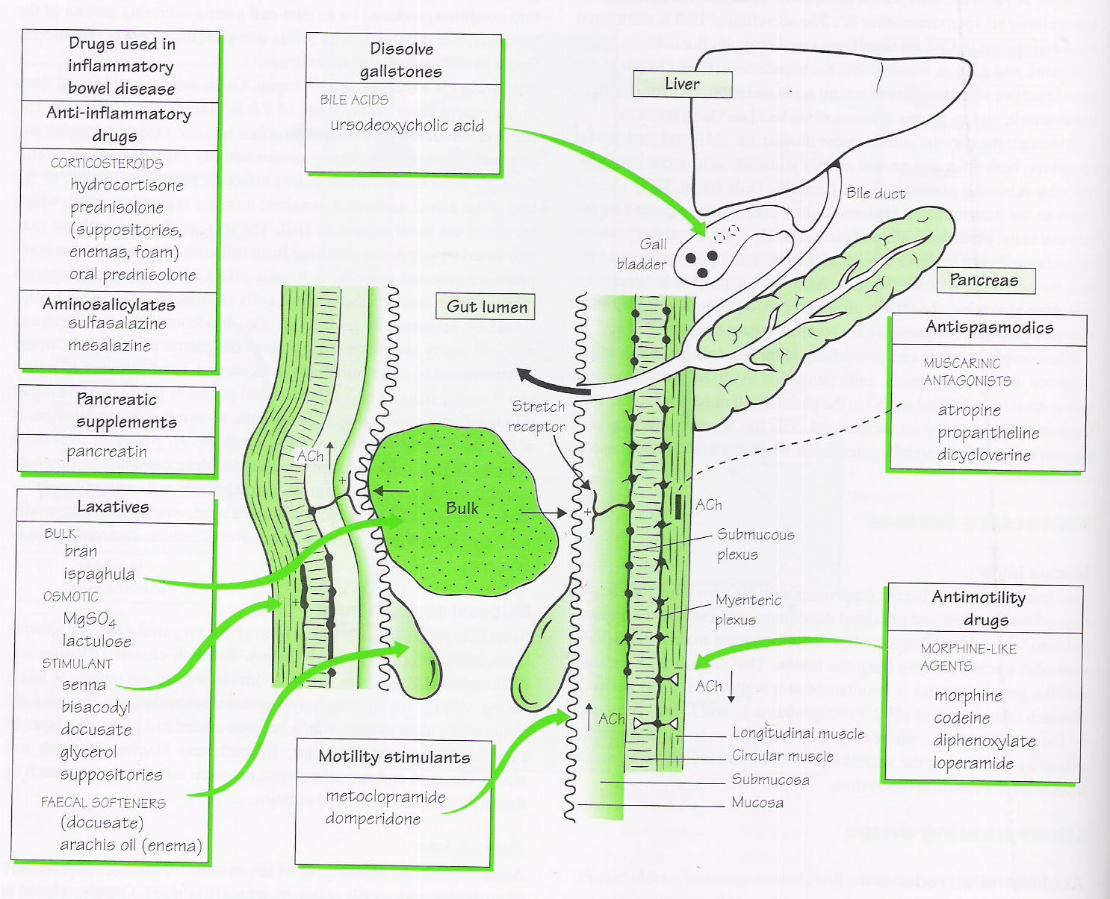
Notes:
Drugs acting on the GIT2: motility and secretions

